Slide 1
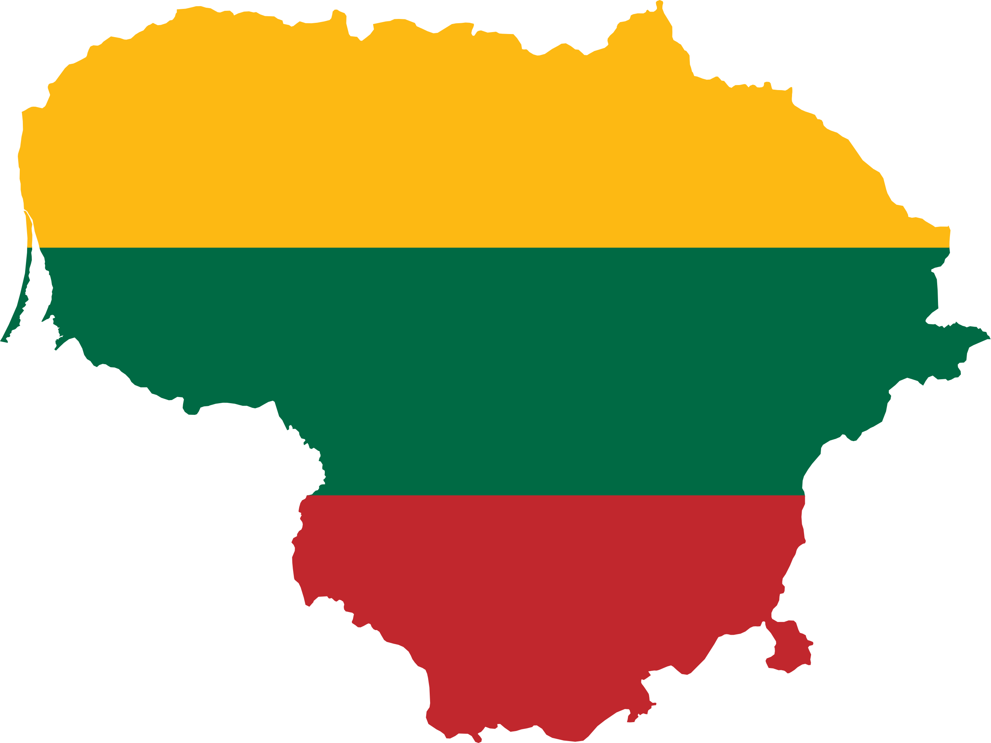
LITHUANIA

Slide 2
CONTENT
01
03
05
Language
Traditions
Monuments
02
04
06
Gabija
gymnasium
History
Cuisine

Slide 3
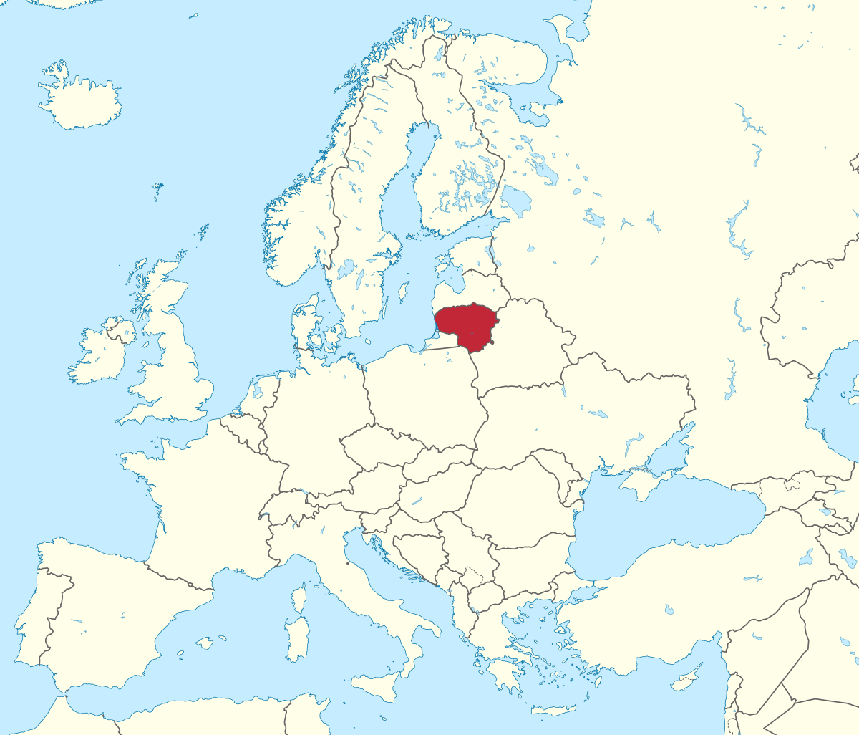
LITHUANIA
CAPITAL: Vilnius
AREA: 65,300 km²
POPULATION: 2,784,279 (2021)
OFFICIAL LANGUAGE: Lithuanian
CURRENCY: Euro
PRESIDENT: Gitanas Nausėda
RELIGION: Christianity (93%)
NEIGHBORING COUNTRIES: Latvia, Poland, Belarus and Russia
NATO: since 2004
EUROPEAN UNION: since 2004

Slide 4

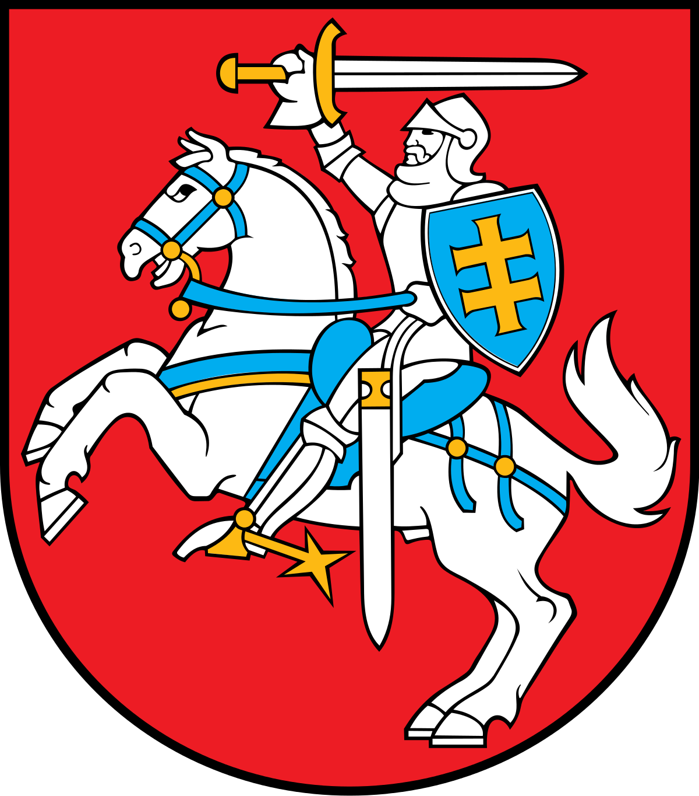
LITHUANIA’S FLAG AND COAT OF ARMS

Slide 5
LITHUANIAN LANGUAGE
01

Slide 6
LITHUANIAN LANGUAGE
MANY WORDS ARE SIMILAR TO SANSKRIT
Lithuanian belongs to the Baltic group of the Indo-European family of languages. It is one of the oldest spoken languages in the world and even has words which cognate in Sanskrit.
LETTER „Ė“
Lithuanians also have a letter „ė“ that does not exist in any other language. This letter is a symbol of femininity, because it is used at the end of women’s names.

Slide 7
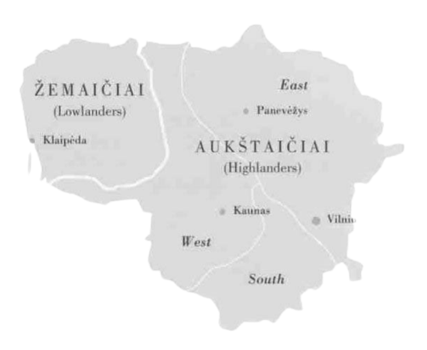
LITHUANIAN DIALECTS
Traditional Lithuanian dialects can be divided into two main groups: Lowland and Highland. These two dialects are so different that a Lowlander cannot easily communicate with an east or south Highlander unless they speak standard Lithuanian.
INDO-EUROPEAN LANGUAGE
Lithuanian is considered somewhat special because, due to historical circumstances, it is extremely conservative in respect to certain grammatical features. It is widely considered to be the best surviving representative of how Proto-Indo-European may have sounded like, and what its grammar could have been like.

Slide 8
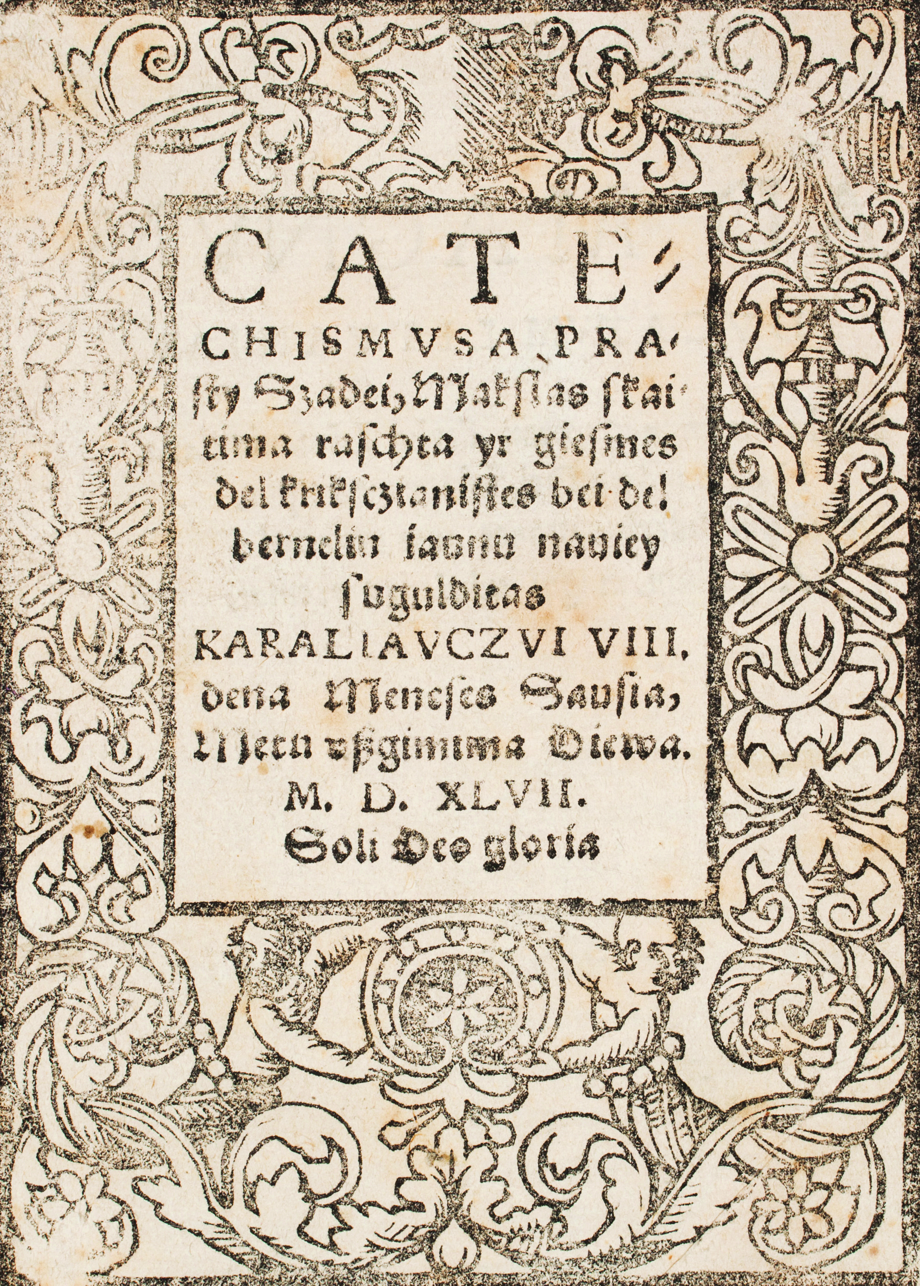
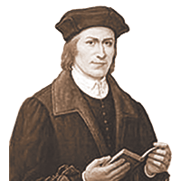
Catechism of Martynas Mažvydas – is the first printed book in the Lithuanian language in 1547.

Slide 9
HISTORY
02

Slide 10
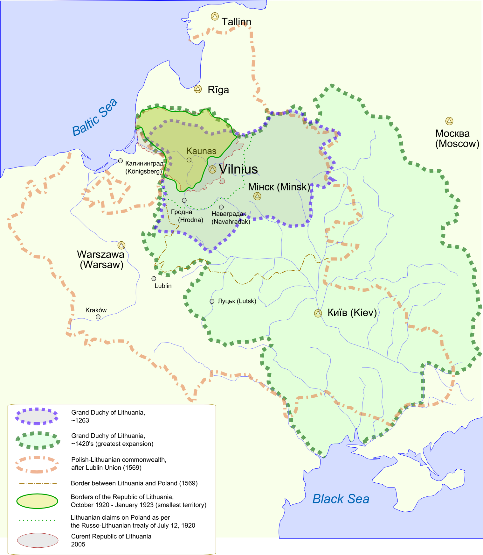
Lithuania, country of north-eastern Europe, the southernmost and largest of the three Baltic states. Lithuania was a powerful empire that dominated much of eastern Europe in the 14th–16th centuries before becoming part of the Polish-Lithuanian confederation for the next two centuries.
Aside from a brief period of independence from 1918 to 1940, Lithuania was occupied by Russia beginning in 1795, was controlled by Germany for a brief period during World War II, and was incorporated into the U.S.S.R. in 1944 as one of its constituent republics. On March 11, 1990, Lithuania declared its independence by a unanimous vote of its newly elected parliament. The new Soviet parliament acknowledged Lithuania’s independence on September 6, 1991.

Slide 11
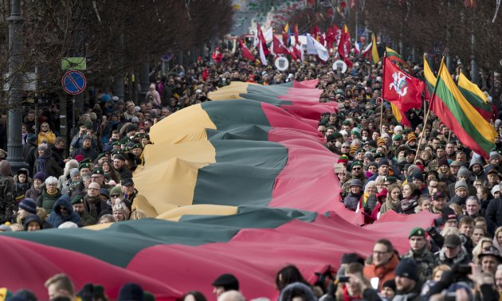
LITHUANIA IS A RELATIVELY “NEW” COUNTRY AS IT HAS ITS INDEPENDENCE ONLY SINCE 1990.

Slide 12
TRADITIONS
03

Slide 13
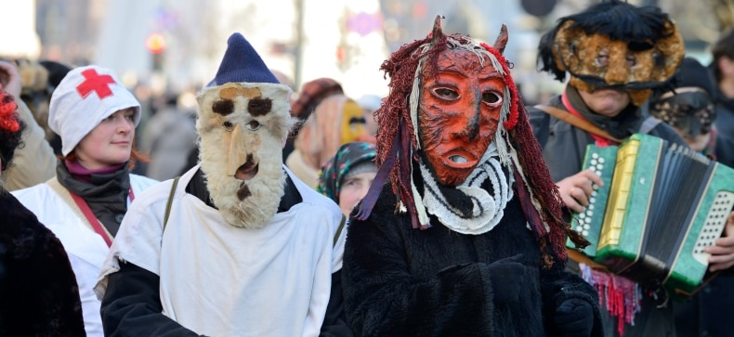
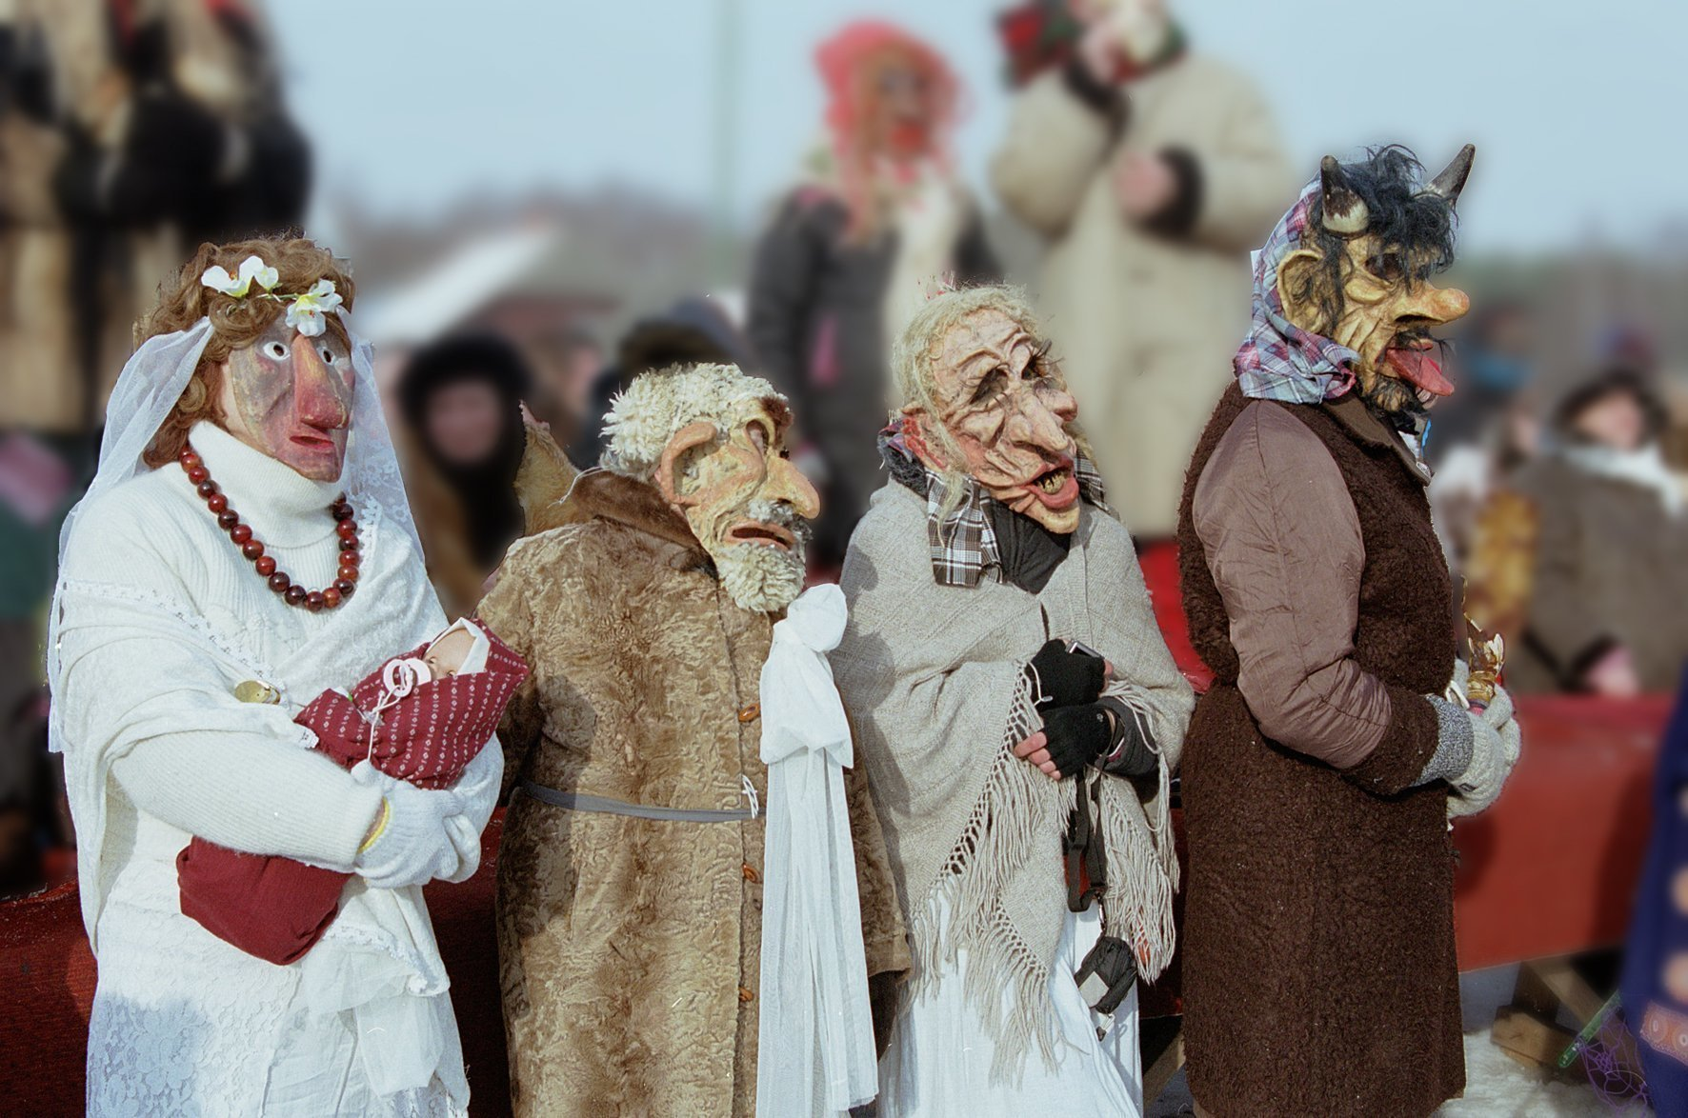
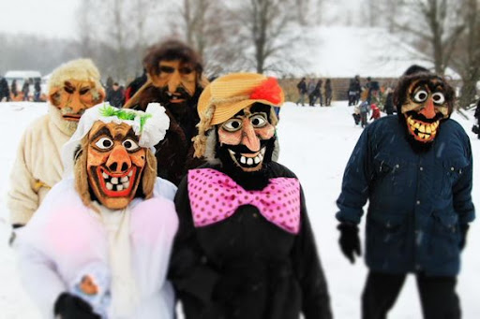
SHROVE TUESDAY
Participants of the carnival of ShRove Tuesday wear impressive masks of the characters of this celebration, eat countless pancakes and other fat dishes, watch characters symbolizing spring and winter fight with each other.

Slide 14
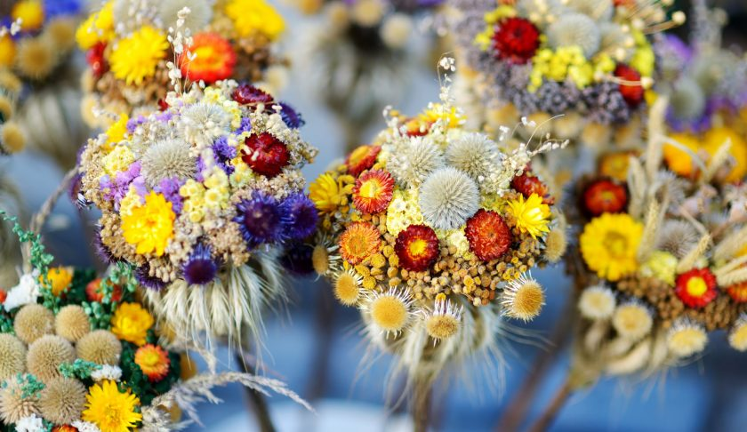
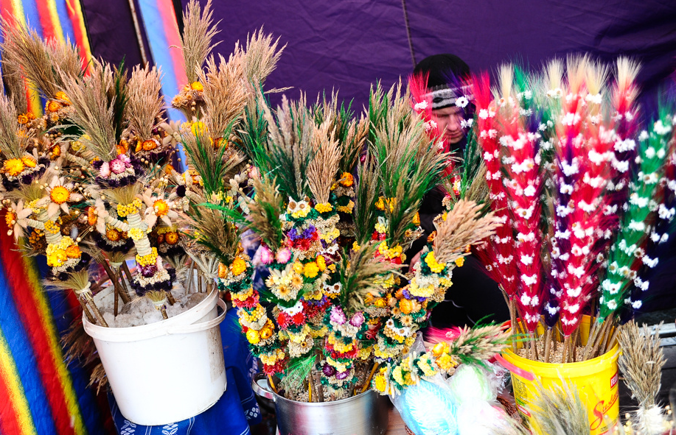
PALM SUNDAY
Lithuanians take branches of juniper or ornate Palm Sunday palms to church to be consecrated, believing that they will protect their home from evil and bad luck the whole year.

Slide 15
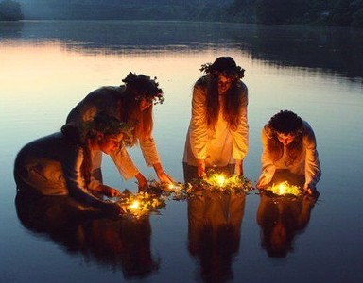
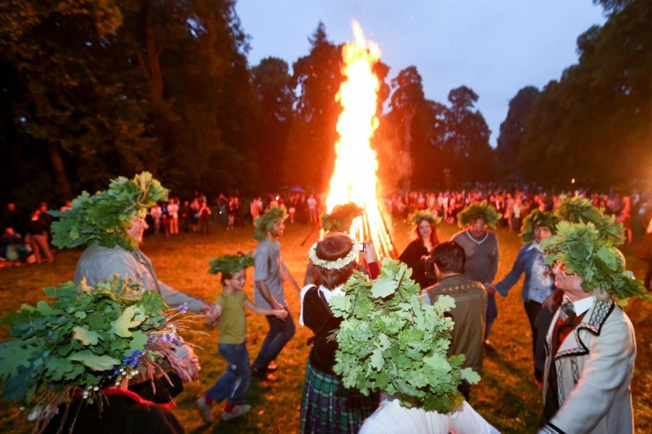
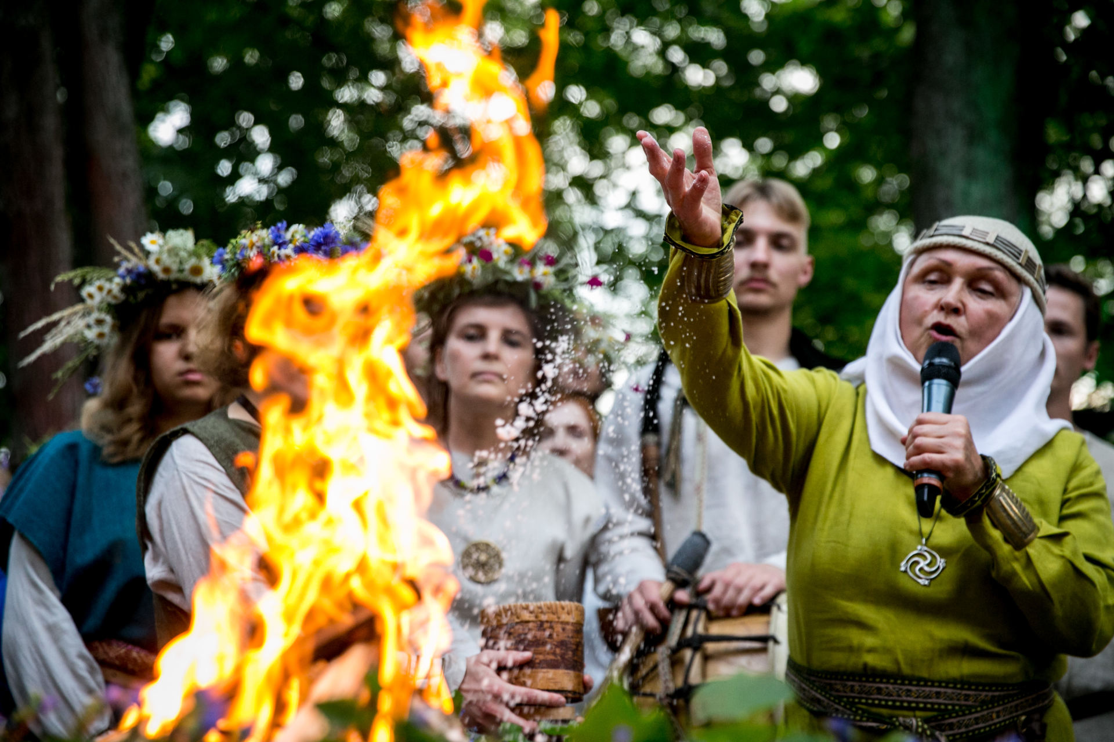
MIDSUMMER NIGHT
The main holiday of the warm season in Lithuania celebrated on the shortest night of the year (June 24), is very romantic. During the Baltic traditional festival normally celebrated in the open air, for example, on the hill forts of Kernavė, Mount Rambynas or in Jonava, women make garlands from grass and flowers, huge bonfires are lit, people dance and sing, and when it gets dark, they set out to search for the mysterious blooming fern.

Slide 16
CUISINE
04

Slide 17
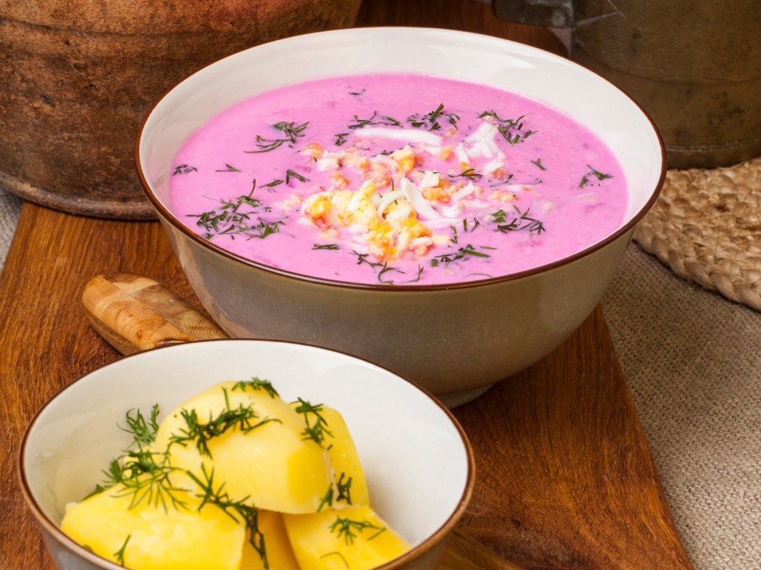
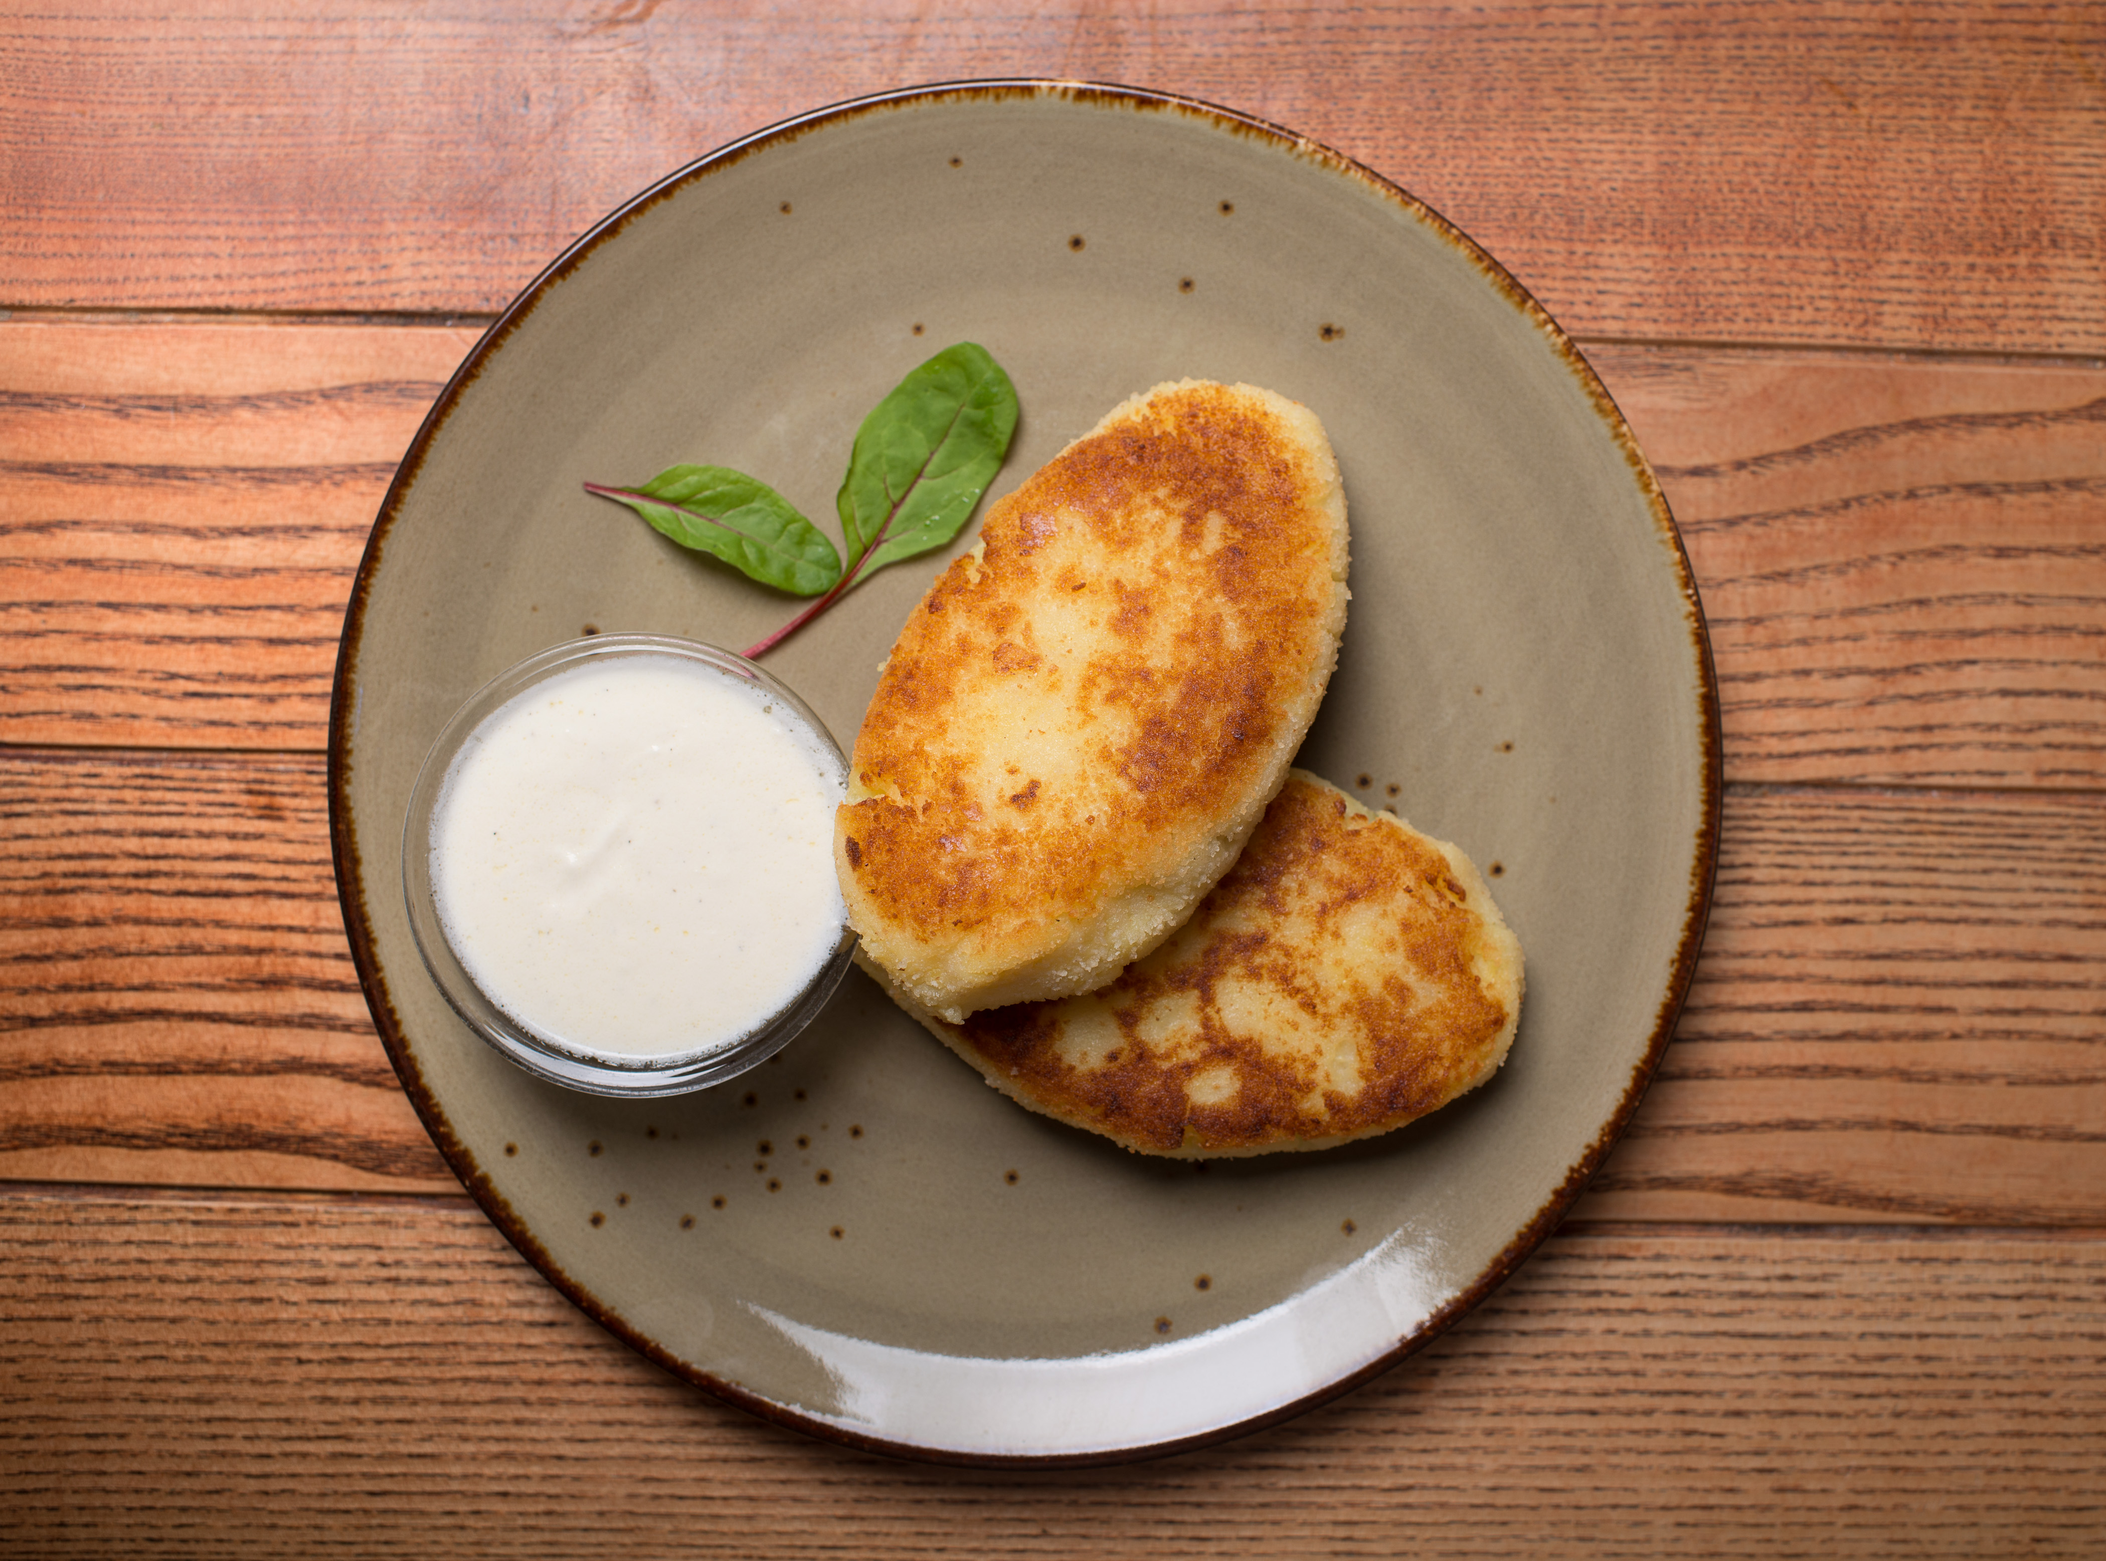
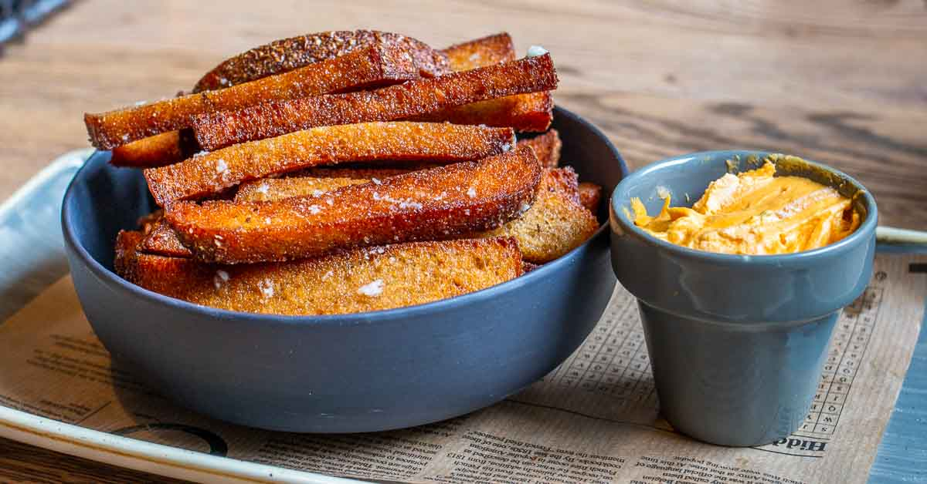
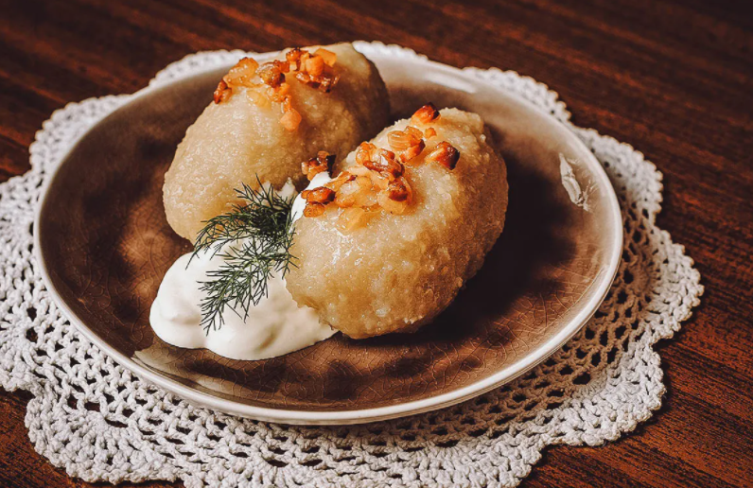
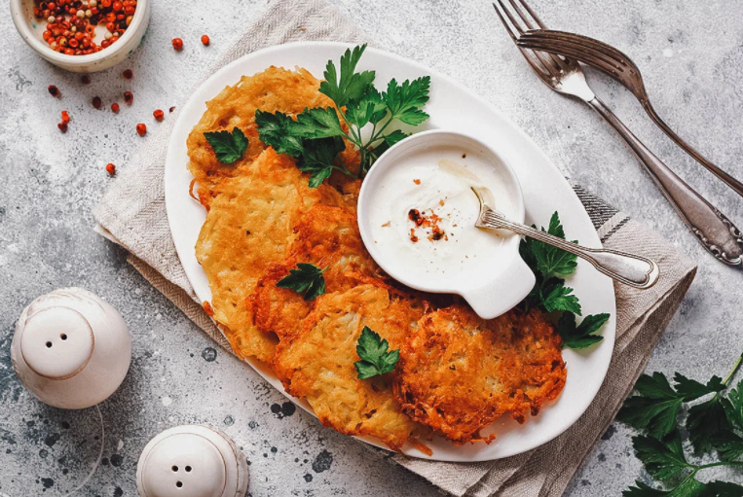
CUISINE
Cold beetroot soup
Šaltibarščiai
Potato-meat dish
Žemaičių blynai
Fried dark bread
Kepta duona
Potato pancakes
Bulviniai blynai
Potato-meat dumplings
Cepelinai

Slide 18
MONUMENTS
05

Slide 19
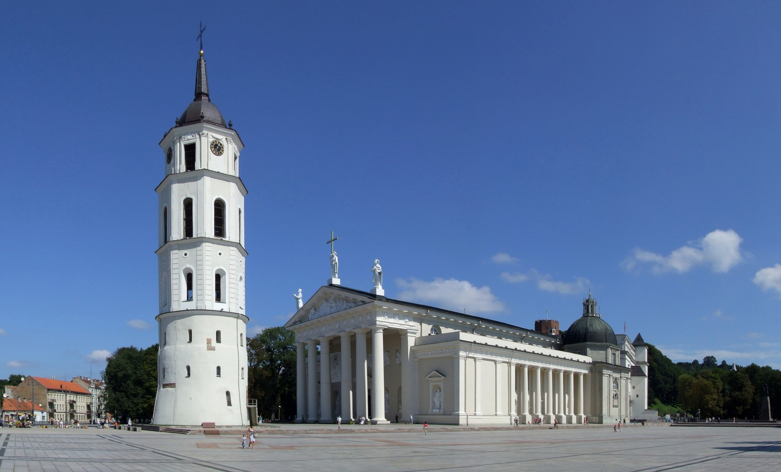
THE CATHEDRAL BASILICA OF ST. STANISLAUS AND ST. LADISLAUS

Slide 20
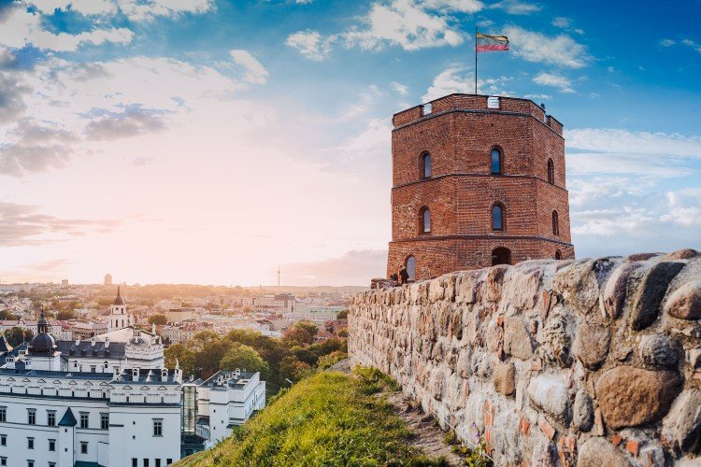
GEDIMINAS TOWER

Slide 21
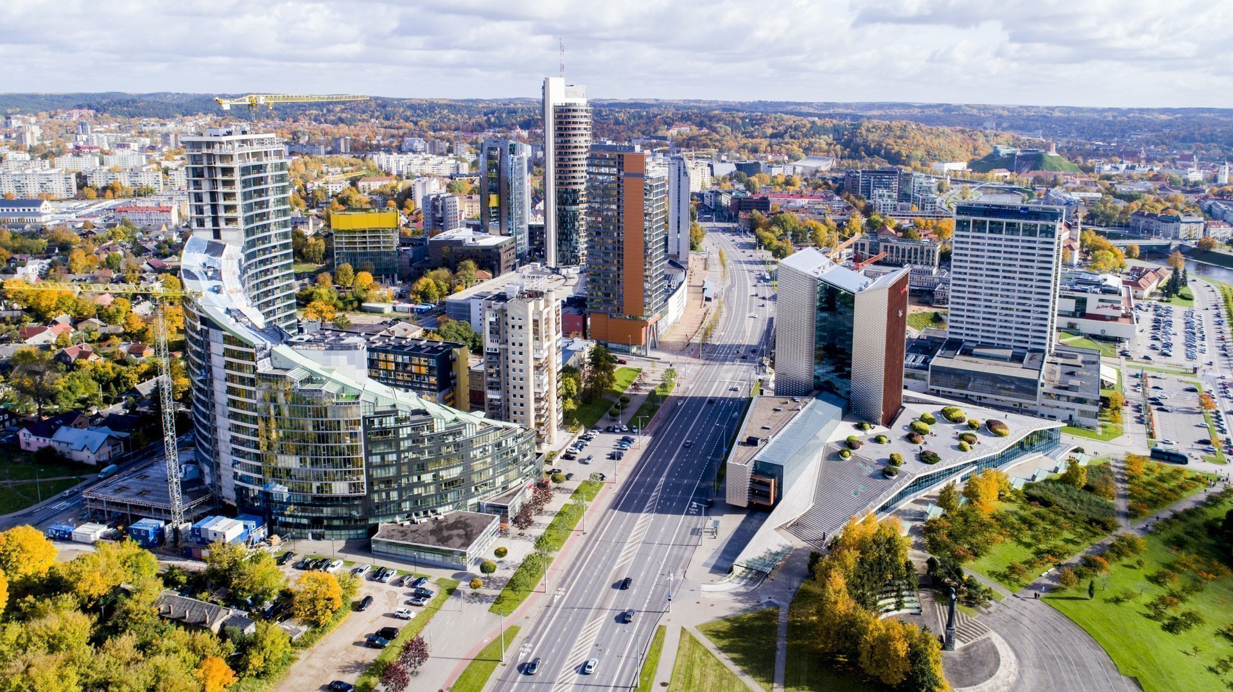
CONSTITUTION AVENUE

Slide 22
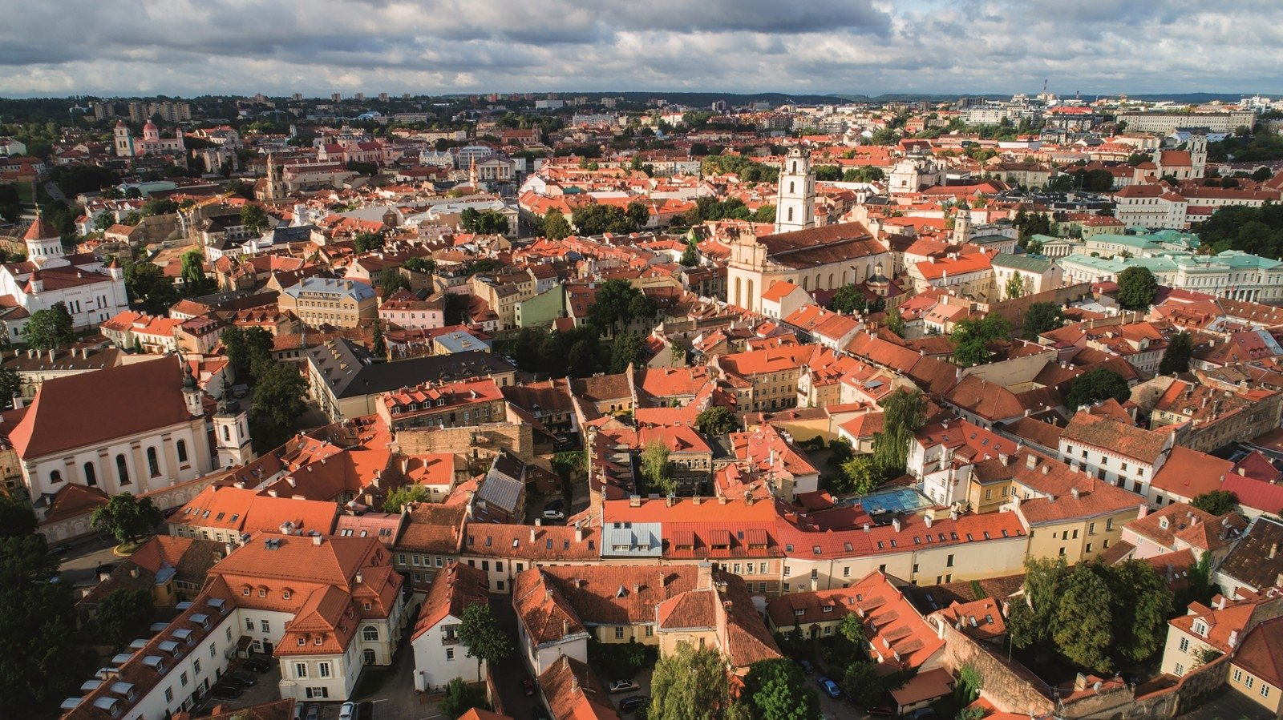
OLD TOWN

Slide 23
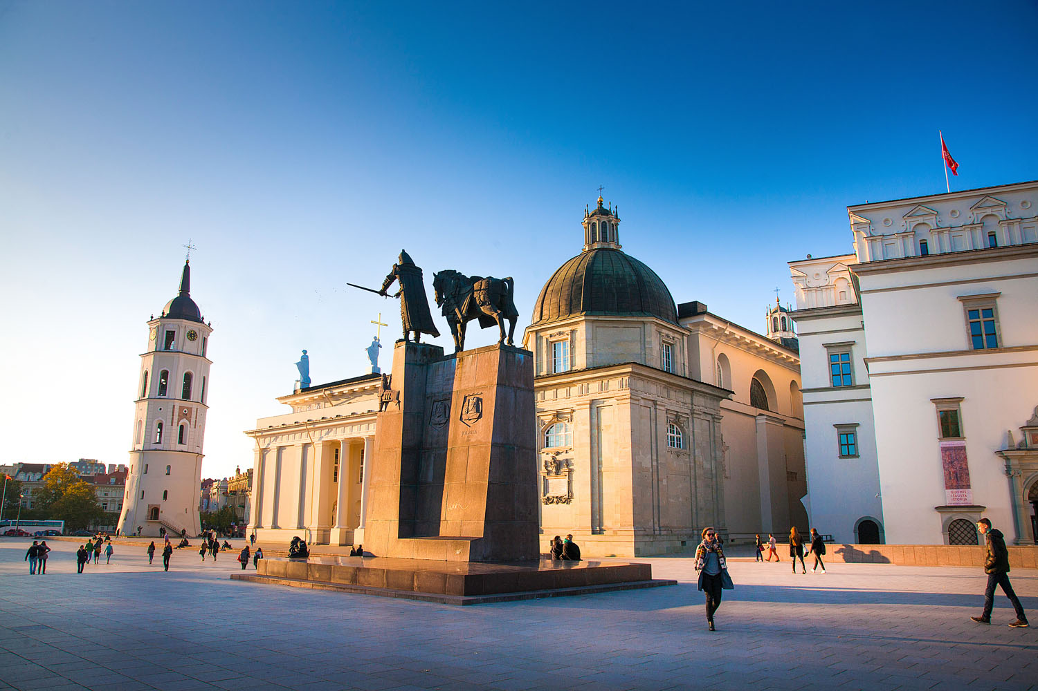
CATHEDRAL SQUARE

Slide 24
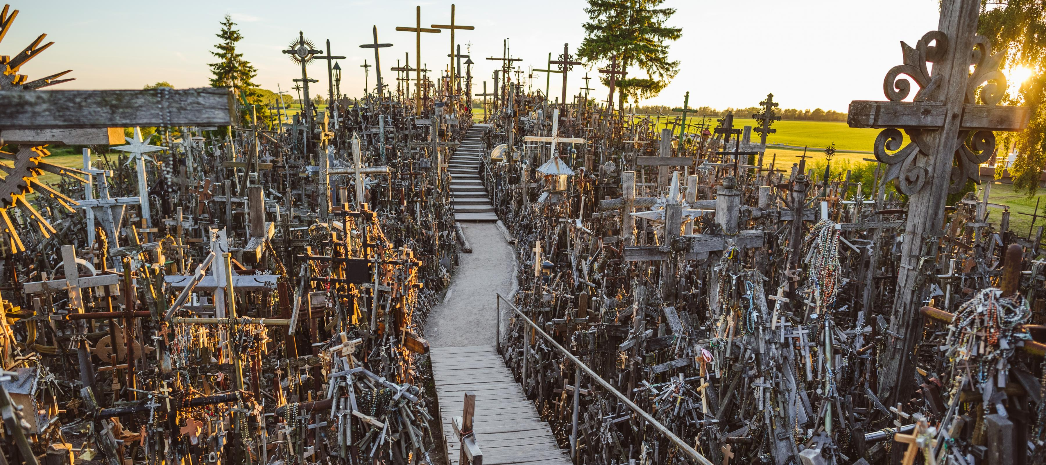
HILL OF CROSSES

Slide 25
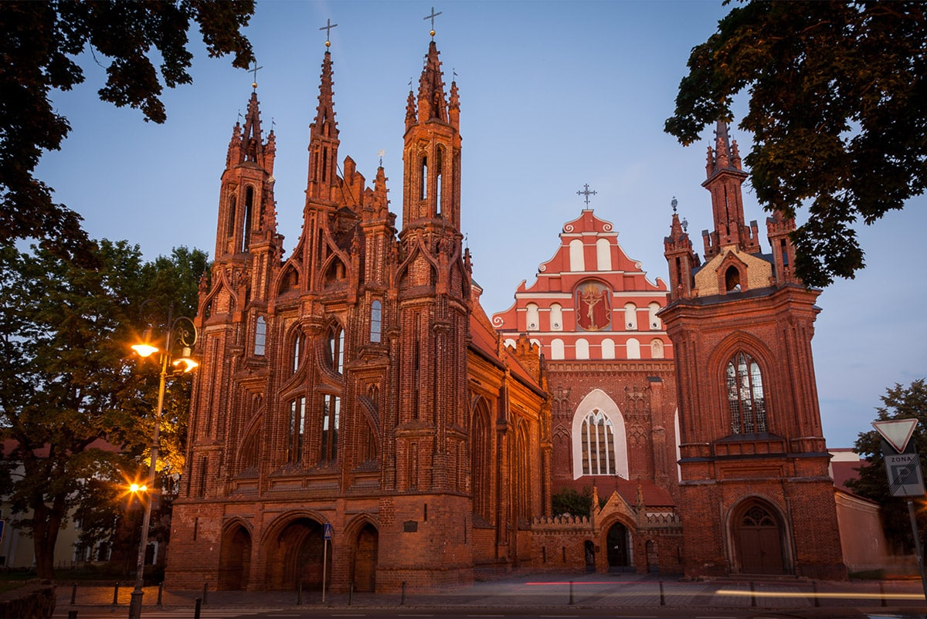
CHURCH OF SAINT ANNE

Slide 26

GABIJA GYMNASIUM
06

Slide 27
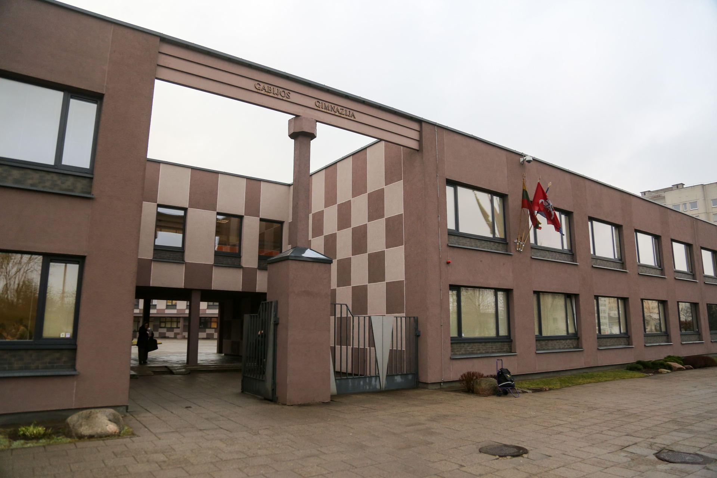
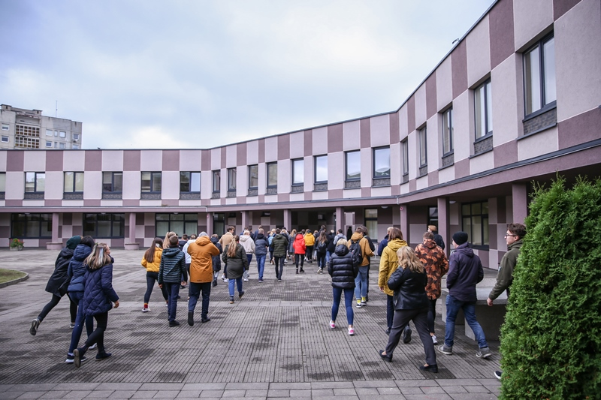
The school started its activities in 1989 as the 62nd secondary school in Vilnius.
In 1993, school was renamed as Gabija gymnasium which obliged and obliges human warmth and light, creative volatile thought and scientific wisdom.

